Slide 1
Presentation for:
Downtown East Toronto Ontario Health Team Performance Measurement and Quality Improvement (PMQI) Working Group
November 5 2021

Slide 2
Presentation by:
Ontario Community Health Profiles Partnership (OCHPP)
Dr. Rick Glazier & OCHPP Team

Slide 3
Today’s presentation
Who we are
Sample maps of select indicators
Overview of the website
Initiate discussion about areas for collaboration, priority indicatorso

Slide 4
Who we are
Specialized team at MAP Centre for Urban Health Solutions, St. Michael’s Hospital working together under the leadership of Dr. Rick Glazier.
Family Physician
Medical Geographer
Spatial Analyst
Epidemiologist/Data Analyst
Webmaster
Program Management
Other research scientists at MAP
Practicum Students

Slide 5
How we do our work
OCHPP is a partnership of health and community agencies.
Our partners include: St. Michael’s Hospital/Unity Health Toronto, Ontario Health (Toronto), Ontario Health (Central), Access Alliance CHC, Wellbeing Toronto, Toronto Public Health, Wellesley Institute, Health Commons Solutions Lab, ConnexOntario, Ottawa Neighbourhood Study, ICES
Joint decision-making on key deliverables and indicators
Publicly-accessible website

Slide 6
How we can help OHTs understand their populations
How we can help OHTs understand their populations
OCHPP can help better understand the characteristics of your attributed populations as well as an understanding of the local areas (neighbourhoods) from where your populations derive. This understanding is important to ensure equitable access to services and care. Some ways we do this:
Capture and layer sociodemographic factors and patterns such as the movement of people or rates of disease stratified by income, sex and age
Identify areas where the distribution of services may not match needs or indicators of geographic accessibility
Calculate distances and travel times, for example from patients and populations to services
Contextualize data, creating opportunities for new insights or avenues of exploration such as creation of custom maps and data
Provide the OHT with access to your data on an open website – OCHPP

Slide 7
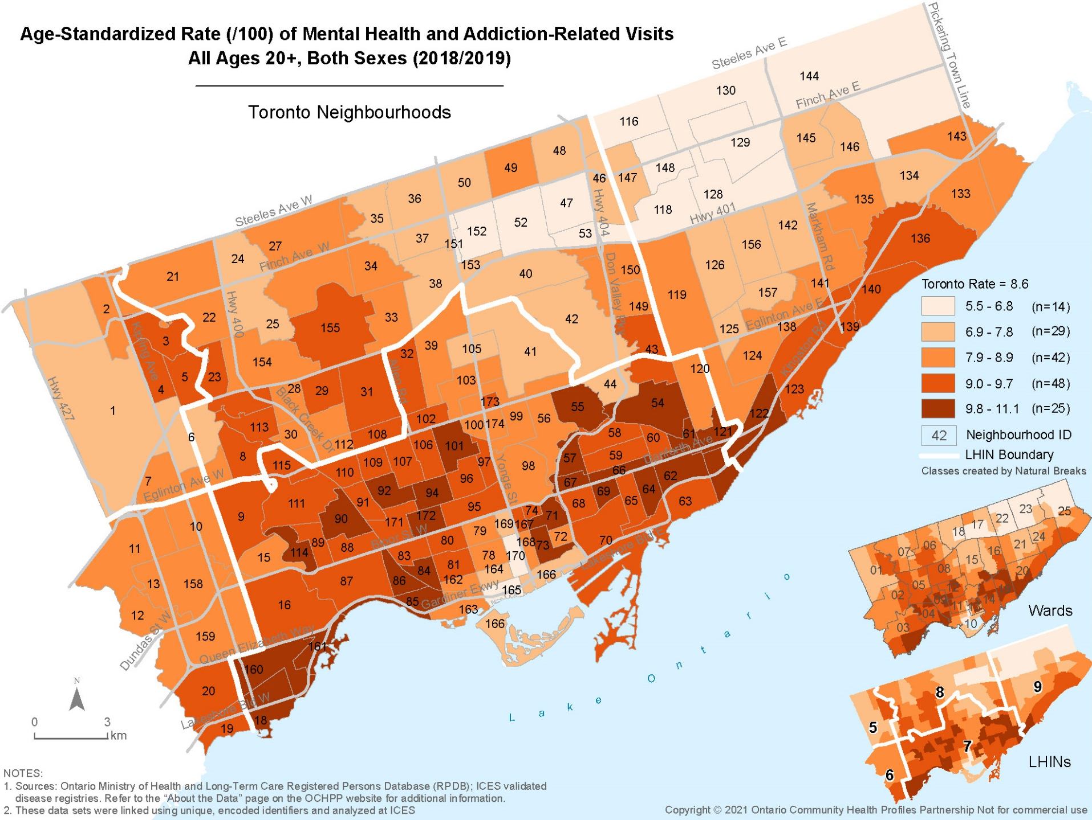
Examples of our work #1: Age-standardized rate of mental
health and addiction-related visits to a primary care provider in Toronto (latest data 2018/19)
How we can help OHTs understand their populations
Mental Health and Addiction-related conditions are defined by the occurrence of a
doctor`s visit for a symptom related to mental health.

Slide 8
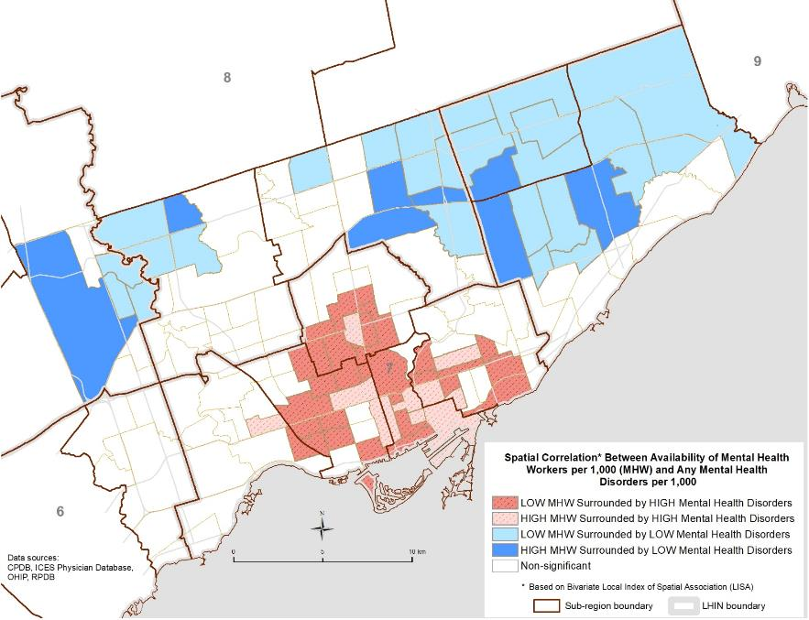
Examples of our work #2: Availability of mental health workers in relation to any mental health disorders (Toronto)
How we can help OHTs understand their populations
Red = High Discordance
Not enough MH workers to
match need – OR – lots of
need and lots of MH
workers.
Possible question that OHT might need to answer:
Where are populations of
our OHT located with
highest unmet Mental
Health and/or Substance
Use?

Slide 9
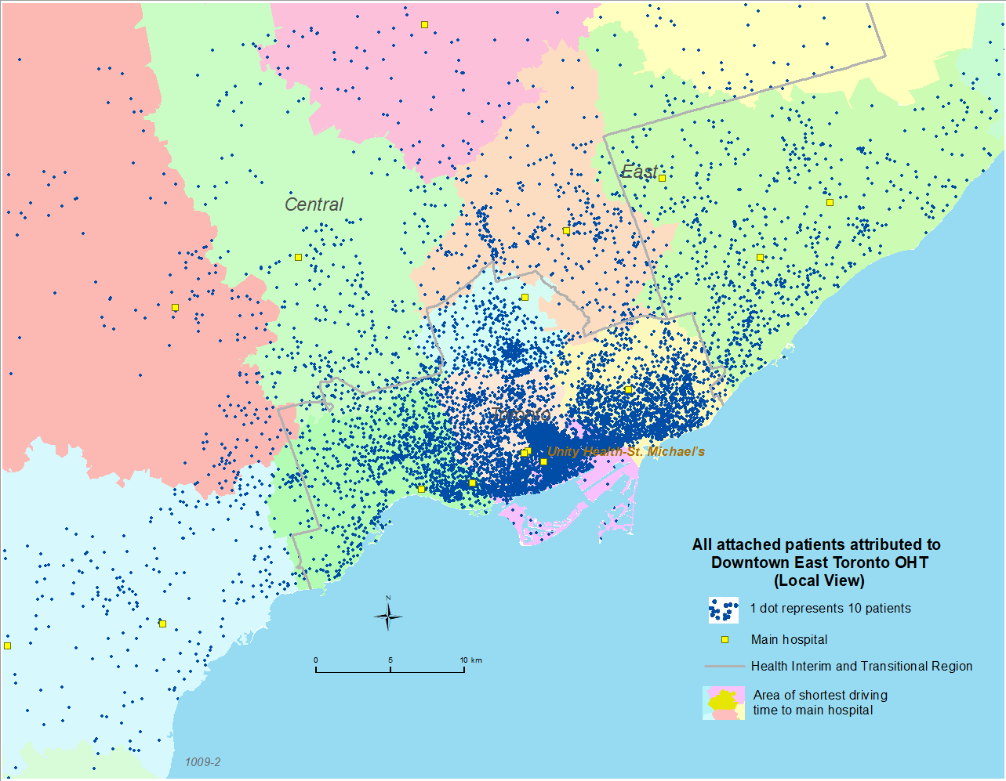
Examples of our work #3: All attached patients attributed to Downtown East Toronto OHT
How we can help OHTs understand their populations
Most of the population attributed to DETOHT live within the vicinity of DETOHT.

Slide 10
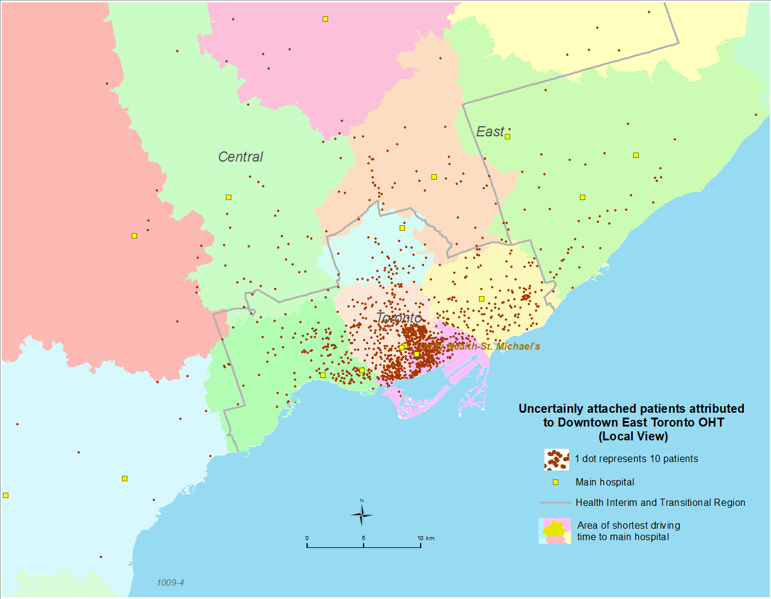
Examples of our work #4: All uncertainly attached patients attributed to Downtown East Toronto OHT
How we can help OHTs understand their populations
Most uncertainly attached patients also live within the vicinity of the DETOHT.

Slide 11
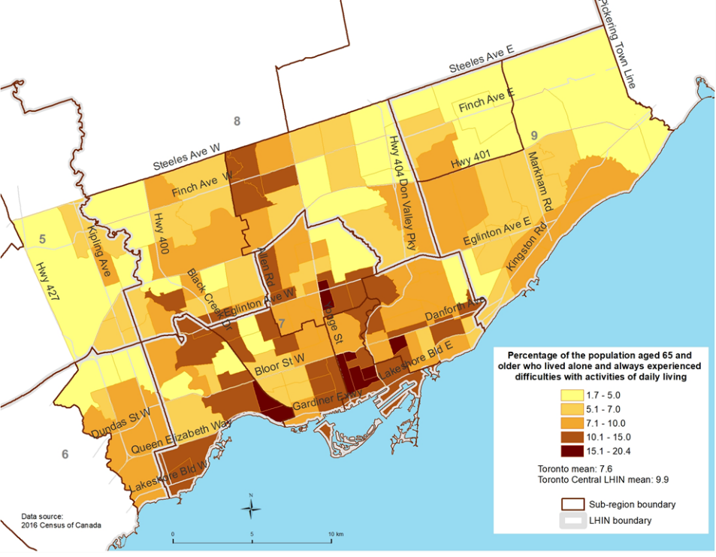
Examples of our work #5: Seniors who live alone and always
experience limitations with activities of daily living (City of Toronto)
How we can help OHTs understand their populations
Red = High % of seniors living
alone with issues of daily
living.
Possible questions that OHT might need to answer:
What services are needed to
serve this growing
population?
Are there other risk factors
associated with this
population?

Slide 12
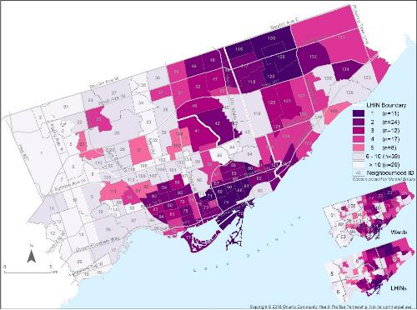
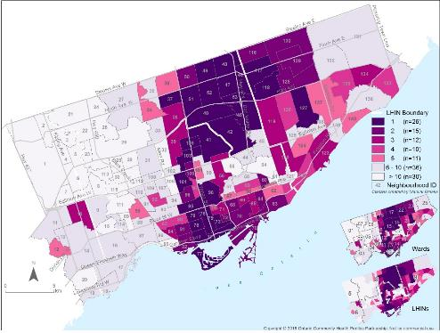
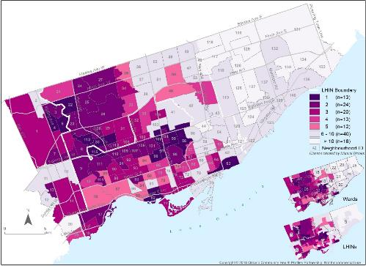
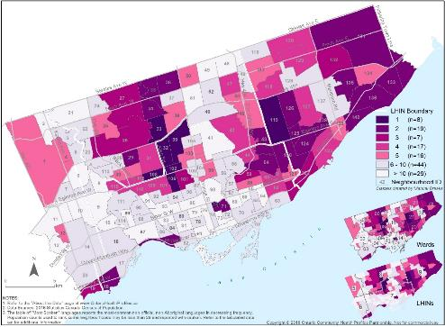
Examples of our work #6: Main languages spoken in Toronto –
Cantonese, Mandarin, Spanish & Tagalog
How we can help OHTs understand their populations
Cantonese
Mandarin
Understanding the languages spoken of the attributed population of DETOHT and provision of culturally specific care and services.
Spanish
Tagalog

Slide 13
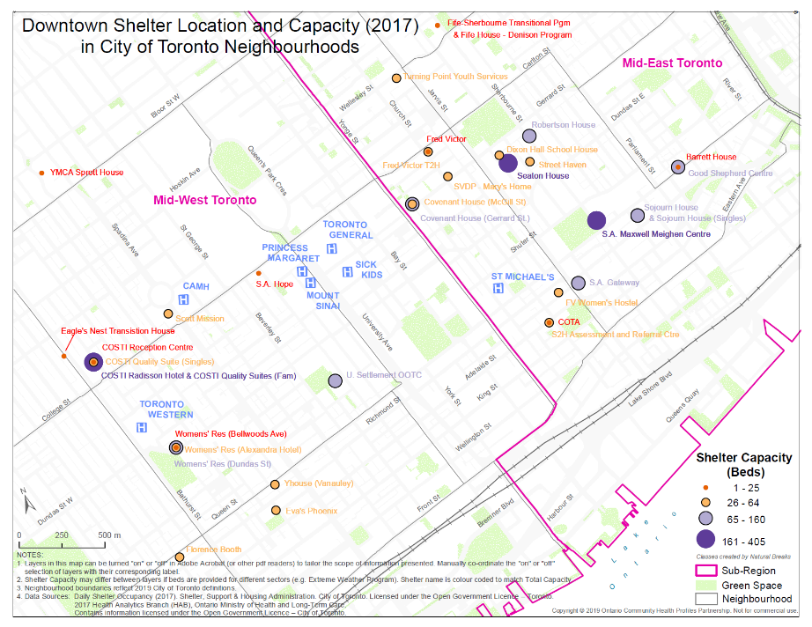
Examples of our work #7: Distribution of Shelters across
Toronto, by sector
How we can help OHTs understand their populations
OCHPP can provide locations maps to assist DETOHT and partners to see where services are provided or needed.

Slide 14
The OCHPP Website
www.OntarioHealthProfiles.ca
Freely accessible website providing updated, validated health indicator data with lots of functionality:
Custom geography
Interactive maps
Charts

Slide 15
Thank you!
Questions?
Feel free to email us or add your name to our mailing list: healthprofiles@smh.ca

